Slide 1
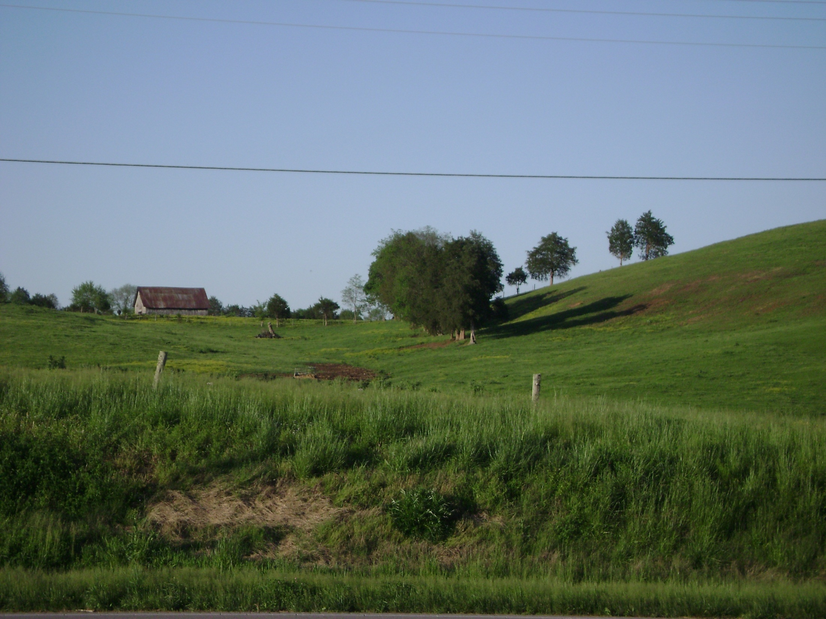
The Holy Spirit
The Work Of The Holy Spirit
The Holy Spirit Was At Work:
In Creation (Gen. 1:2, 26; Job 33:4)
In Salvation (Lk. 1:34-35; Matt. 1:20)
In Inspiration/Revelation (II Pet. 1:20-21)

Slide 2
The Holy Spirit
The Work Of The Holy Spirit
The Holy Spirit’s work in salvation ….
Showed people who Christ was (Matt. 3:16-17; Jn. 1:32-33).
Led Christ into the wilderness (Matt. 4:1).
Jesus had “spirit without measure” (Jn. 3:34).
Declared the Son of God (Rom. 1:4).

Slide 3
The Holy Spirit
The Work Of The Holy Spirit
Christ’s Promise To The Apostles ….
John 14:16-17, 25-26
John 15:26
John 16:13
Some apply these verses to modern-day.
WRONG! (Jn. 15:26-27, 16:16)
John 14-16 is fulfilled in Acts 2:1-4!

Slide 4
The Holy Spirit
The Work Of The Holy Spirit
Other Times We See The Holy Spirit’s Work:
Acts 8:29, 39 (Philip and the Eunuch)
Acts 10-11 (Cornelius)
Acts 10:19-20, 11:12 (Peter told to go)
Acts 10:44-46, 11:15 (Were Cornelius and his family saved right then?)

Slide 5
The Holy Spirit
The Work Of The Holy Spirit
Other Times We See The Holy Spirit’s Work:
If Cornelius and his house was saved before and without baptism ….
Peter didn’t know it (Acts 10:47-48)!
Cornelius and his family didn’t know it!
The Jews’ response to this (Acts 11:18).
It never happened again (Acts 15; Rom.; Gal.; Eph. 3:3-6).

Slide 6
The Holy Spirit
The Work Of The Holy Spirit
Other Times We See The Holy Spirit’s Work:
Acts 16:6-10 (At one point, the Holy Spirit did not allow the men to go to Asia and Bithynia.)
Romans 15:18-19
I Timothy 4:1-5

