Slide 2
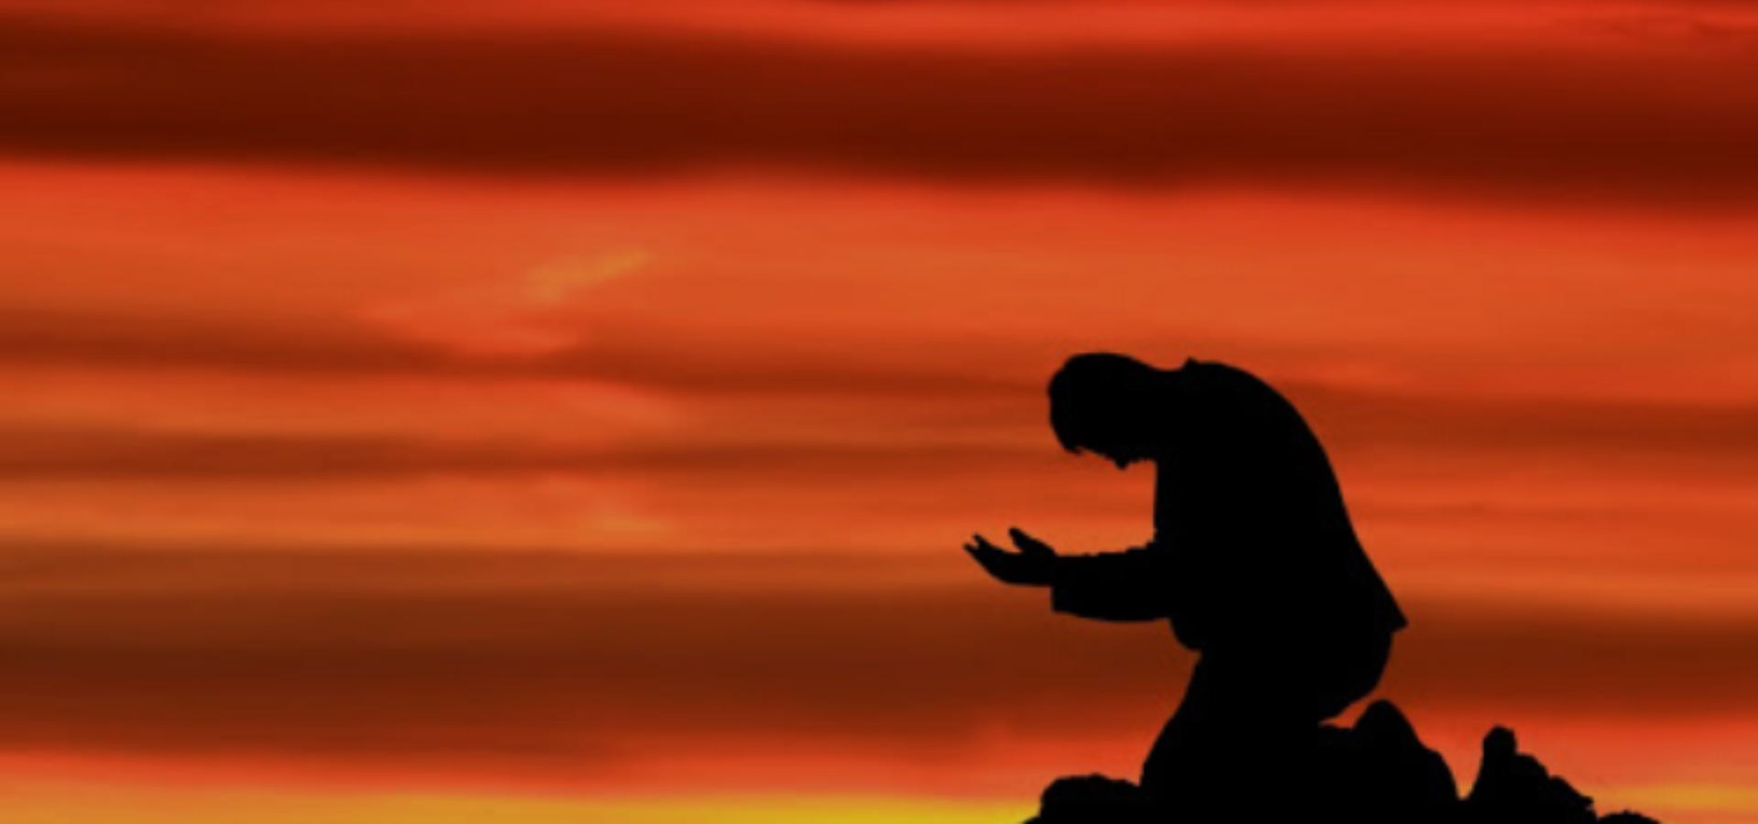
How God Rewards The Faithful

Slide 3
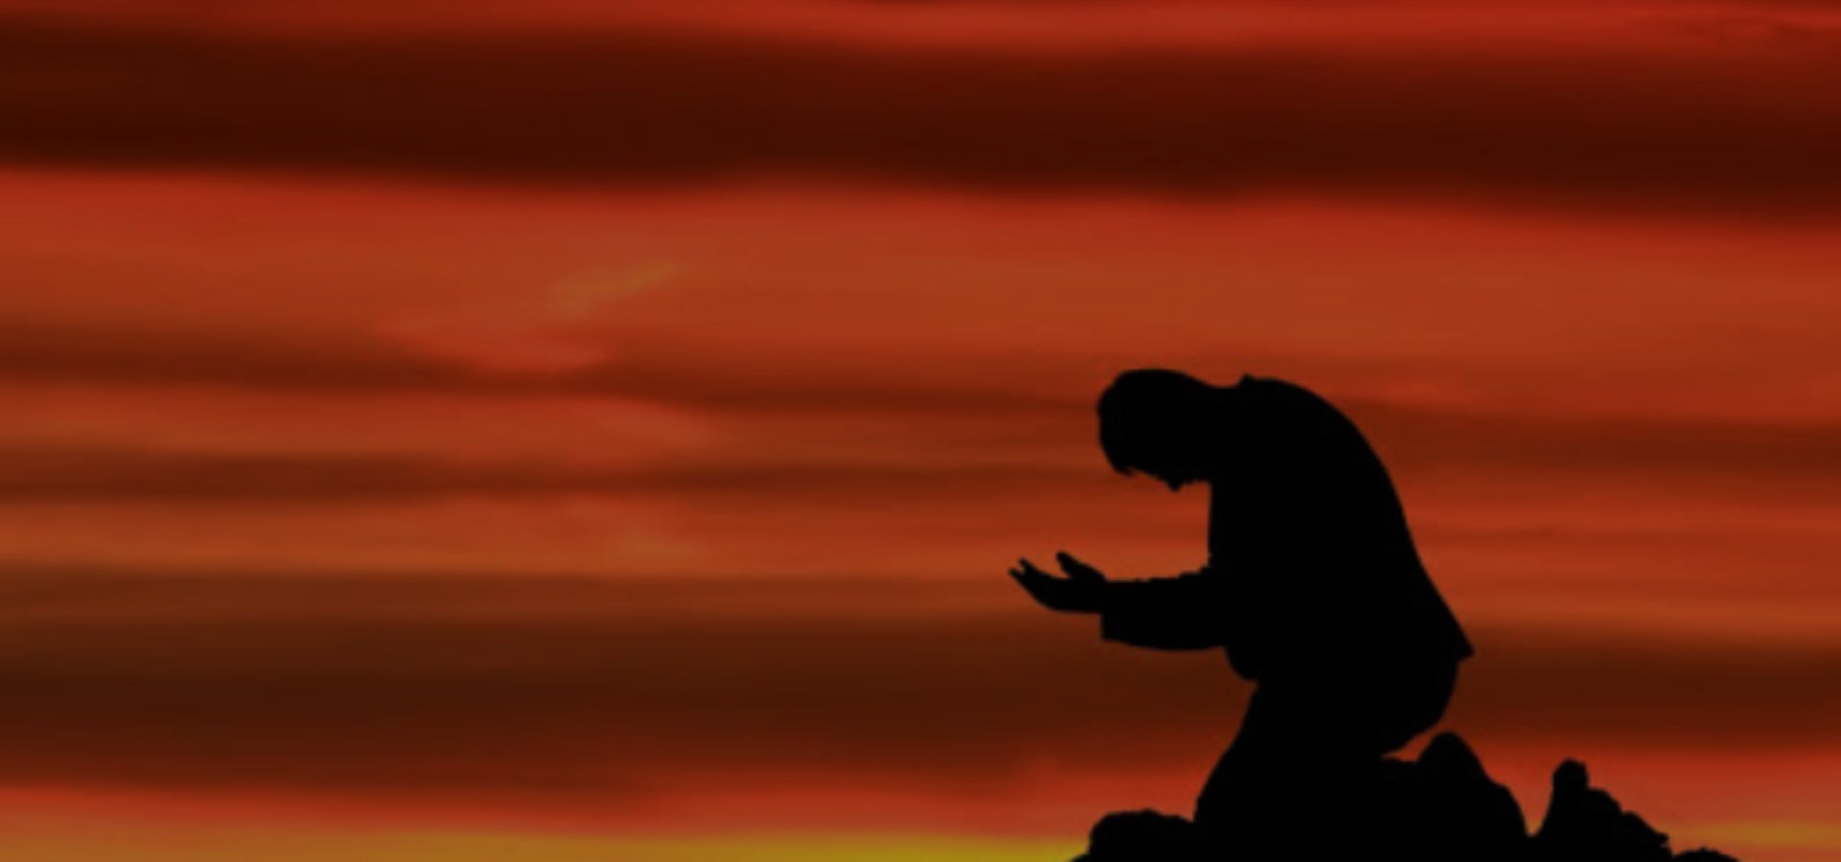
God’s Followers Face Real Problems
Hannah’s womb was closed – 1 Sam. 1:1-5
Hannah was constantly harassed – 1 Sam. 1:6-7
Even loving family members can’t take away all pain – 1 Sam. 1:8
Hannah kept worshipping God throughout these trials – 1 Sam. 1:7
The best way to deal with pain is to give it to God – 1 Sam. 1:9-10; 1 Pet. 5:7
Notes:
1Pe 5:7 casting all your anxieties on him, because he cares for you.

Slide 4
God Rewards Faithful Prayer
Throughout her trials, Hannah worshipped God – 1 Sam. 1:7
At the height of her distress, she prayed to God:
  With anguish to deep for words – 1 Sam. 1:10
  Possibly unable to even speak – 1 Sam. 1:13
  Pouring out her heart and soul – 1 Sam. 1:15-16
  With a solemn vow – 1 Sam. 1:11
  Continually praying – 1 Sam. 1:12
  Left her request with God – 1 Sam. 1:17-18
Hannah showed the kind of heart God looks for – 2 Chron. 16:9
Notes:
2Ch 16:9 For the eyes of the LORD run to and fro throughout the whole earth, to give strong support to those whose heart is blameless toward him. You have done foolishly in this, for from now on you will have wars.”

Slide 5
God Rewards Faithful Endurance
Sometimes we think this only applies to our Heavenly reward – Heb. 12:1-4
God recognized Hannah’s faith – 1 Sam. 1:19
Hannah named her son “God heard me” – 1 Sam. 1:20
God listens to our requests – 1 Jn. 5:14
God is looking out for our best interest – Rom. 8:28
Samuel goes on to replace a lack luster Judge
Notes:
1Jn 5:14 And this is the confidence that we have toward him, that if we ask anything according to his will he hears us.
Rom 8:28 And we know that for those who love God all things work together for good, for those who are called according to his purpose.

Slide 6
God Rewards Thankfulness
Hannah remembered her promise early on – 1 Sam. 1:21-22
Hannah kept her vow – 1 Sam. 1:23-27
Hannah still worshipped God – 1 Sam. 1:28
Do we intend to keep the vows, promises, and plans we make? – Jas. 5:12
Do we serve God with the gratitude of Hannah? – Col. 3:17
Notes:
Jas 5:12 But above all, my brothers, do not swear, either by heaven or by earth or by any other oath, but let your “yes” be yes and your “no” be no, so that you may not fall under condemnation.
Col 3:17 And whatever you do, in word or deed, do everything in the name of the Lord Jesus, giving thanks to God the Father through him.

Slide 7
Is Our Faith Deepening?
Hannah remembered to come back and show God her gratitude and worship – 1 Sam. 2:1
Hannah’s faith in God deepened – 1 Sam. 2:2-10
God continued to be with Hannah – 1 Sam. 2:21
Let us pray like Hannah – Col. 4:2
Let us rejoice like Hannah – Heb. 13:15
Let our faith continue to increase – Lam. 3:22-23
Notes:
Col 4:2 Continue steadfastly in prayer, being watchful in it with thanksgiving.
Heb 13:15 Through him then let us continually offer up a sacrifice of praise to God, that is, the fruit of lips that acknowledge his name.
Lam 3:22-23 The steadfast love of the LORD never ceases; his mercies never come to an end; (23) they are new every morning; great is your faithfulness.

Slide 8
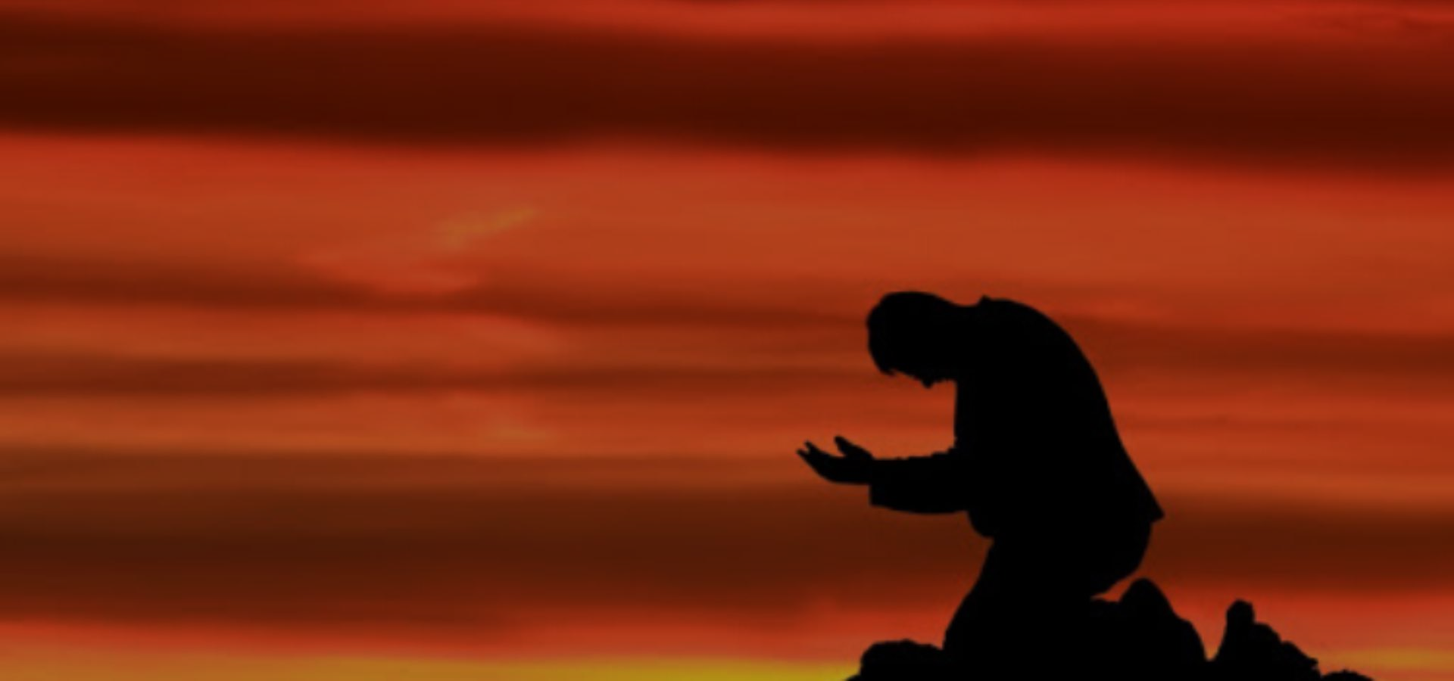
Will You Show Faith To God Today?
Hear the Gospel – Romans 10:17
Believe in Christ – Acts 16:31
Repent of your sins – Acts 17:30
Confess Christ – Romans 10:10
Be Baptized – 1 Peter 3:21
Will You Repent In Faith?
Repent (Acts 8:22), Confess Your Sins (1 Jn. 1:9),
Pray (Acts 8:22), Stay Faithful (Rev. 2:10)

